Slide 1
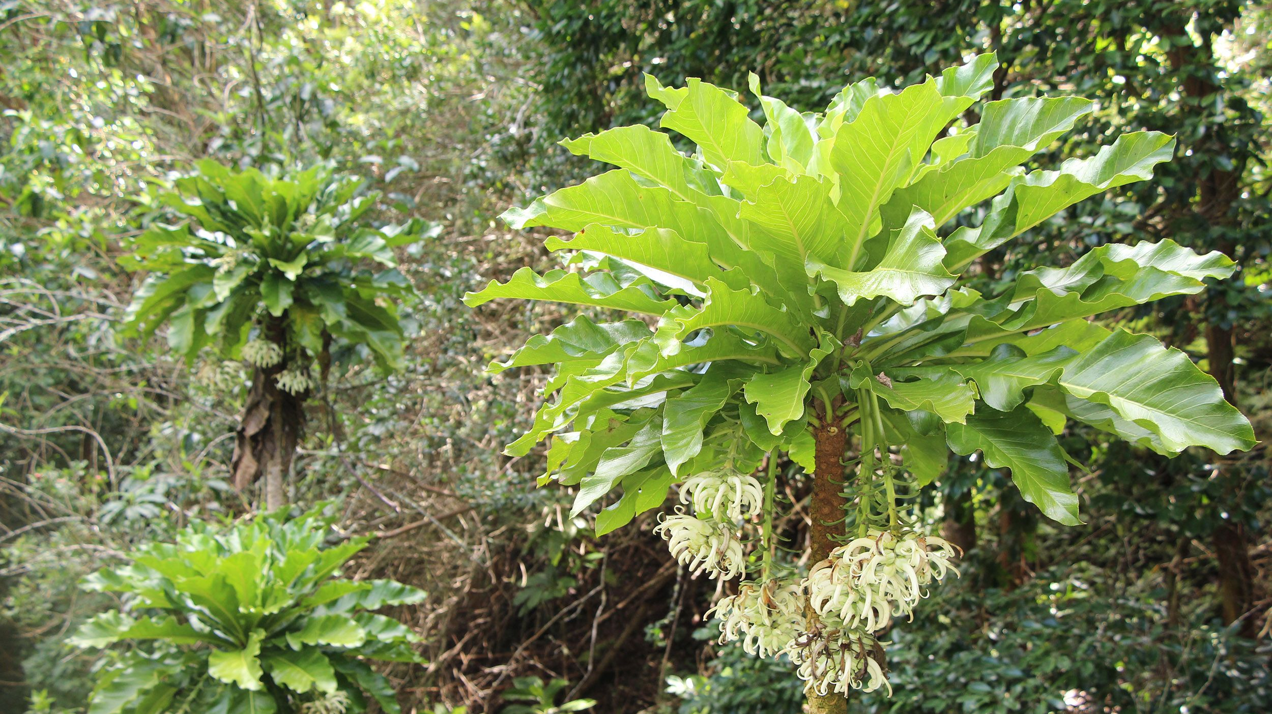
International Union for Conservation of Nature and Natural Resources (ICUN) Red List
Data trends found in extinct plant species
-Katherine Burke-

Slide 2
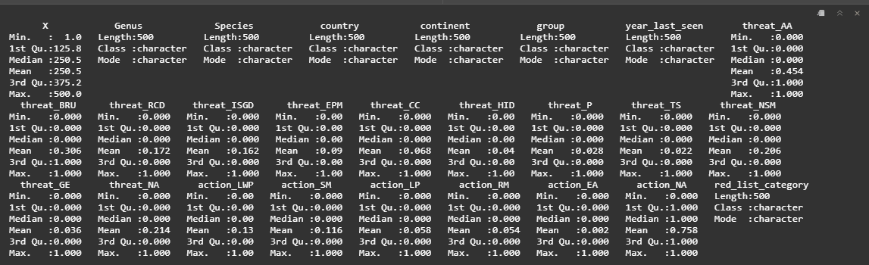
At A Glance

Slide 3
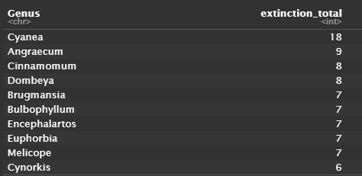
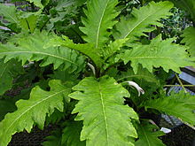
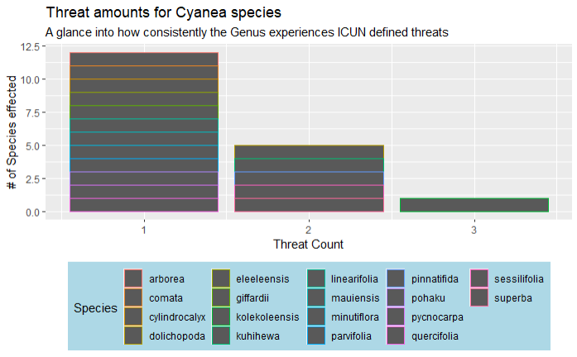
A Look Into The Outlier:

Slide 4
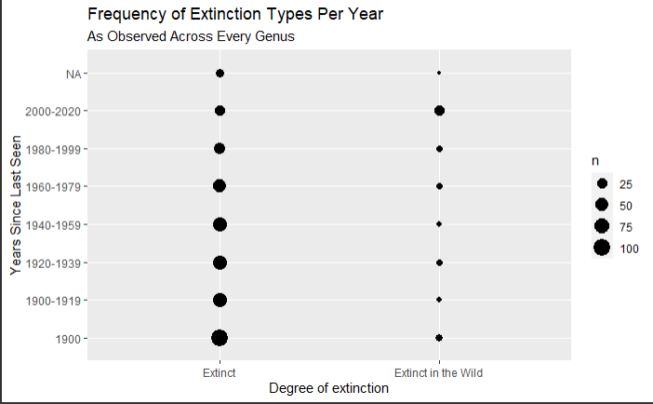
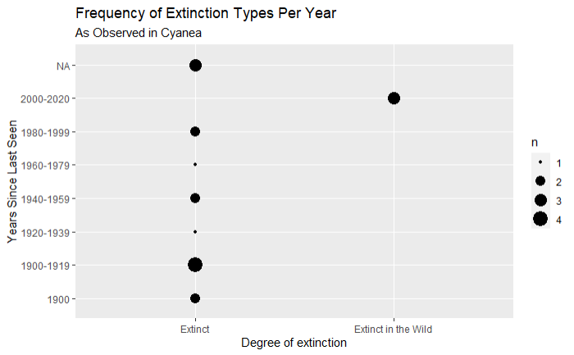
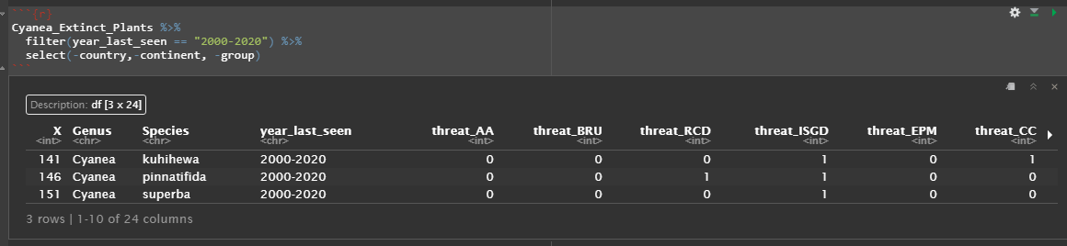
A Glance Into Circumstance

Slide 5
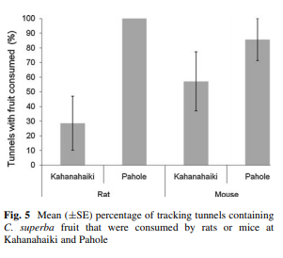
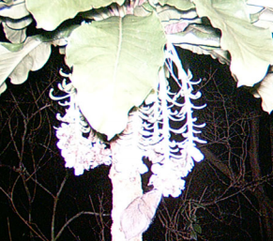
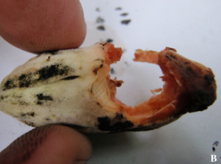
Application to real-world trends
A look into Cyanea superba
“The goals for genetic storage of Cyanea superba have been partially met. While the Army has initiated several actions to protect C. superba and the species has reached the stabilization numbers, the threats have not all been controlled, and genetic storage is not complete. The down listing, and recovery goals for this species have not been met and, therefore, C. superba meets the definition of endangered as it remains in danger of extinction throughout all of its range”
- 5-year review, U.S. Fish and Wildlife Service Pacific Islands Fish and Wildlife Office Honolulu, Hawaii

Slide 6
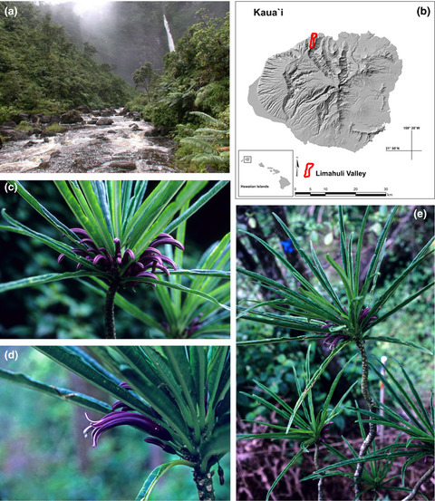
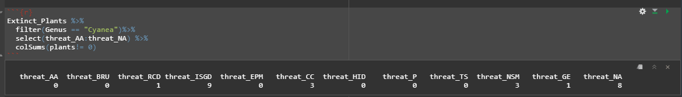
Continued.
Cyanea Kuhihewa, and stories missing data can tell. Investigating the “Unknown” factor of threats.
Also, why Hawaii?

Slide 7
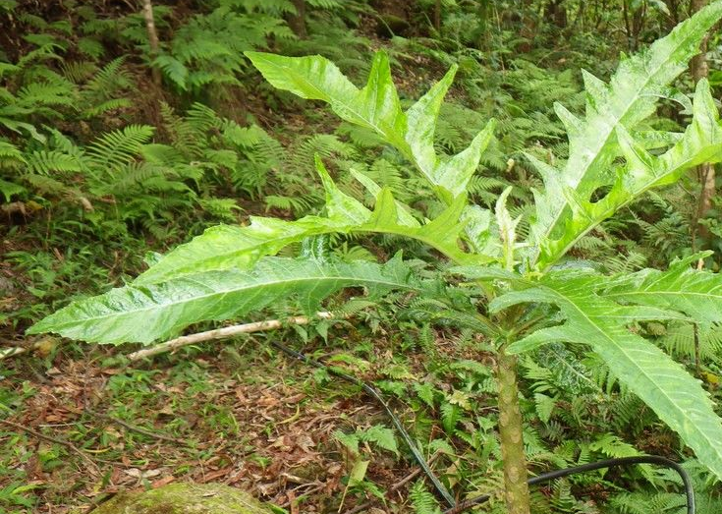
A Disturbing Trend
The tragedy of Cyanea pinnatifida, and what is says for Hawaii’s endemic life.

Slide 8
Sources:
Link to dataset used (includes original source):
https://github.com/LiminalAegis/final_project_SM2021/tree/master/data
ICUN: https://www.iucnredlist.org/
Christina Crooker https://scholarspace.manoa.hawaii.edu/bitstream/10125/10404/uhm_ms_3912_r.pdf
FWS: https://ecos.fws.gov/docs/five_year_review/doc1131.pdf
UNL: https://digitalcommons.unl.edu/cgi/viewcontent.cgi?article=2548&context=icwdm_usdanwrc
DLNR: https://dlnr.hawaii.gov/wildlife/files/2013/09/Fact-Sheet-Cyanea-pinnatifida.pdf
DOI: https://www.publicgardens.org/file/46700/download?token=4PbQJleN

